Slide 1

Course Structure
JTI Period End Closing Model
Statutory and Tax Ledger Closing Principles
Key Timings and Usage of Posting Periods
A Glance of Period End Closing Process
Period End Closing Key Focus Areas
Using FCC to monitor Period End Closing

Slide 2
Course Structure
JTI Period End Closing Model
Statutory and Tax Ledger Closing Principles
Key Timings and Usage of Posting Periods
Overview of Key Closing Deadlines
A Glance of Period End Closing Process
P14 STAT/TAX Year-End Process
Period End Closing Key Focus Areas
Using FCC to monitor Period End Closing

Slide 3
Course Structure
JTI Period End Closing Model
Statutory and Tax Ledger Closing Principles
Key Timings and Usage of Posting Periods
Overview of Key Closing Deadlines
A Glance of Period End Closing Process
P14 STAT/TAX Year-End Process
Period End Closing Key Focus Areas
Using FCC to monitor Period End Closing

Slide 4


Key Period End Closing Timelines
Monthly ledger closing:
IFRS Ledger closing cut-off - remains as is on WD3.
Statutory Ledger closing cut-off established on WD10. ¹⁾
No monthly closing of posting periods for Statutory Extension Ledger S1 (i.e. all remain open until the annual cut-off date).
Tax Ledgers closing cut-off established on WD10 (will be closed in parallel with Statutory ledger). ¹⁾
No monthly closing of posting periods for Tax Extension Ledger T1 (i.e. all remain open until the annual cut-off date).
Annual ledger closing:
Although we reserved special posting period P13 as a placeholder for IFRS reporting adjustments, based on JTI practices with the close of P12 on WD3 in January, IFRS ledger is closed and ready for annual reporting.
Statutory Ledger closing cut-off - end June for YE manual ledger specific postings (FA, ML–COGM, AP, AR, CM, FSCM will need to be closed as per monthly calendar).
Statutory Extension ledger S1 closed only annually – end of June.
Tax Ledger closing cut-off - end September for YE manual ledger specific postings (FA, ML -COGM, AP, AR, CM, FSCM will need to be closed as per monthly calendar).
Tax Extension ledger T1 closed only annually - end September.
Use of Posting Periods:
Standard Posting Periods P1-P12 to be used for bookings in IFRS and any compulsory monthly activities for STAT and TAX.
Special Posting Periods: P13-P16 are sustained, however each has been assigned with a specific usage (see coming slides for further details).
¹⁾ Exceptions exist. See Period End Closing Overview course. For JT the STTX cut-off day is WD07.

Slide 5

Ledger Closing Timelines and Corporate Reporting Requirements
Various corporate and local reporting timelines are driving the cut-off times by which we need to close various ledgers:
We have to close IFRS ledger on Jan WD3 to enable Deloitte sign-off on CD19.
We have to close STAT and S1 ledgers (i.e. finalize audited Statutory Financial Statements and Country by Country (CbC) reporting adjustments) by end June which enables submission of Country by Country (CbC) Reporting packs to Corporate Accounting by 30th June. Local entities may need to have their STAT books finalized earlier if legal deadlines prescribe earlier timeline than the corporate end June one.
We have to close TAX and T1 ledgers (i.e. finalize CIT returns including Tax Temporary and Permanent differences) by end of September to enable submission of Japanese Controlled Foreign Company (JCFC) Reporting packs for Corporate Accounting by 30th September. Locally entities may need to have their CIT returns finalized earlier if legal deadlines prescribe earlier timeline than the corporate end September one. Highly automated SAP based JCFC reporting will be executed for 2020 financials due to JT in 2021.

Slide 6
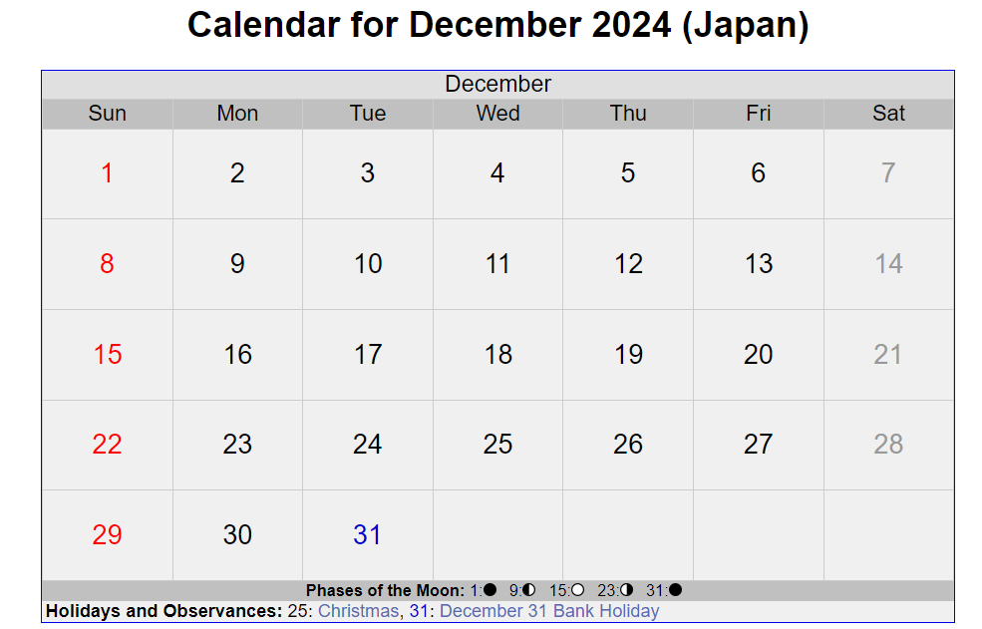
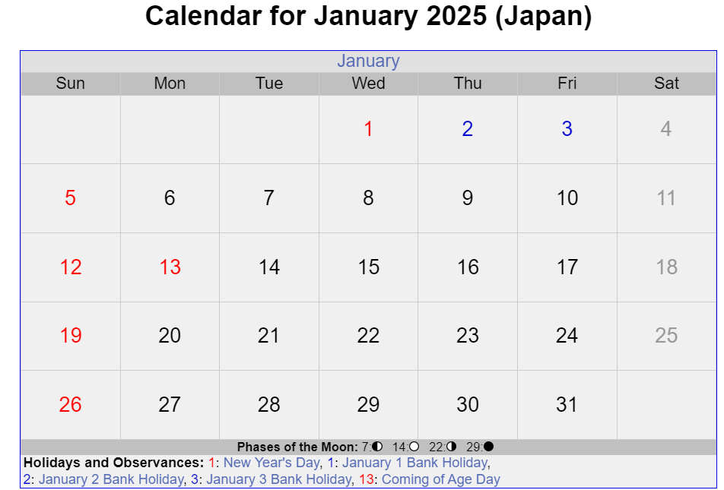
Holiday Calendar- Exception Japan & Geneva Hybrid Calendar
Japan should follow the Geneva Calendar for the Closing Periods P1-P11.
Starting from P12 2024 closing, the closing calendar will be based on Hybrid calendar (Jan 1-3 are treated as non-working days). This is applicable to all JTI.
Closing of P12 (2024)
In January 2025, the 1st Working Day, would be 6th of January. This is applicable to all JTI.

Slide 7









Use of Special Posting Periods P13 – P16
For standardization and audit trail, governance will be established behind the usage of the Special Posting Periods:
Postings in P13:
In IFRS ledger only and only as placeholder
For running year IFRS specific adjustments post IFRS ledger close (although practically unlikely)
Postings in P14:
In Statutory and Tax ledgers ST and TX:
for current year ledger specific manual postings/adjustments post P12 close until finalization of Statutory Financial Statements (audit sign off and CIT return finalization).
In Statutory Extension ledger S1: for annual CbC Reporting adjustments
In Tax Extension ledger T1: for annual Tax Perm Tagging
Postings in P15:
In Statutory and Tax ledgers ST and TX only
For any exceptional retrospective Statutory or Tax adjustments (upon Market CFO approval), which have occurred after the statutory audit and CIT filing.
Postings in P16:
In all core ledgers
For any technical and migration activities / adjustments.
P13
P14
P15
P16

Slide 8
Process Overview: Retrospective Adjustments
There may be valid situations (e.g. post financial audit or tax audit), when retrospective adjustments in closed prior periods are required.
In liaison with the GBS and R2R CC/FCG we have developed a process of retrospective adjustments in closed periods:
Entity
Entity
GBS
R2R CC
Follow the standard MyRequest Journal process for posting to be made in the already closed posting periods in and/or STAT, TAX, S1, T1 ledgers.
Ensure the e-mail confirmation is attached to the MyRequest journal template containing ¹⁾ :
Explanation of the reason/criticality of the re-opening of period and posting of journal;
CFO approval.
Upon noticing that posting is designated into a closed period:
Validate that e-mail justification/CFO approval is attached to MyRequest and will re-open the required ledger, post and close:
Post the adjustment (ST, TX, T1 ledgers may be concerned) in special posting period P15 if it is required after STAT audit or CIT filing.
Post the adjustment in relevant standard posting periods P1-P12 if it is for entities which have the approved exception documented in the GRM (see footnote ¹⁾ below).
Any of such retrospective adjustments
- may impact on what we have reported for CbCR or JCFC;
- may need to be analysed from the perspective of STAT/TAX ledger closing process/timing efficiency
they will therefore be monitored by R2R CC.
¹⁾ Please consult R2R Competency Center for the most up to date documented exceptions which allow entities to request a closed posting period (P1-P12) to be open and post an retrospective adjustment. The requirement of supporting documents and approvals are also documented for each approved exception.

Slide 9
Course Structure
JTI Period End Closing Model
Statutory and Tax Ledger Closing Principles
Key Timings and Usage of Posting Periods
Overview of Key Closing Deadlines
A Glance of Period End Closing Process
P14 STAT/TAX Year-End Process
Period End Closing Key Focus Areas
Using FCC to monitor Period End Closing

Slide 10
Key Period End Closing Timelines for STAT/TAX Ledgers
Monthly ledger closing:
Statutory Ledger closing cut-off established on WD10* .
Tax Ledgers closing cut-off established on WD10* (will be closed in parallel with Statutory ledger).
Annual ledger closing:
Statutory Ledger and Tax Ledger closing cut-off - end June and end of September respectively for YE manual ledger specific postings (FA, ML–COGM, AP, AR, CM, FSCM will need to be closed as per monthly calendar).
Use of Posting Periods:
Standard Posting Periods P1-P12 to be used for bookings in IFRS and any compulsory monthly activities for STAT and TAX.
Special Posting Periods: P13-P16 each has been assigned with a specific usage:
P14 is to be used in ST/TX ledgers for current year ledger specific manual postings/adjustments post P12 close until finalization of Statutory Financial Statements (audit sign off and CIT return finalization). Postings are to be made via MyRequest GL Journal Templates.
* Exception for JT on WD07.
10

Slide 11
STAT/TAX Ledger Year End Posting Process
P12
Close IFRS Ledger
P12
Close STAT & TAX Ledger
P14
STAT & TAX Ledger Adjustments
Annual Closing STAT Ledger by end June
Annual Closing TAX Ledger by end September
Reversals of P14 STAT/TAX Ledger Adj.
P14 Adjustment Journal Posting
FX Revaluation / Translation
Functional Area Adjustments
AP/AR Regrouping
Posting via MyRequest GL Journal template
Posting Date 31.12.20xx
Accounting Entries: Most of the cases will be accrual or provisions postings with Dr. P&L, Cr. B/S
No automatic Revaluation or Translation in P14 due to lack of benefit compared to excessive effort *
Any FX impacts, where relevant, needs to be included in the journal posting template *.
Applicable to entities which use Functional Area Adjustment program
Functional Adjustment Reclassification in P14 is to be done by GBS upon entity request by email**.
AP/AR regrouping is not concerned with STAT/TAX Year End process, as AP and AR reconciliation accounts are closed with P12 AP/AR close.
* 1) Auto runs for P14 postings would trigger a need for a complex set-up, testing and administration in system terms with multiple dependencies and risk of errors:
such runs would be needed in Feb - June of the following year, it would trigger complex chains of reversals of monthly UFX entries and subsequent UFX postings for later periods whereas the carryforwards/opening balances of several subsequent periods will be affected;
entities have different methods used in revaluation programs; therefore different solutions would be required to ensure correctness of UFX for multiple periods due to P14 revaluation run.
2) Time management of additional runs would make GBS processes more complicated.
JTI entities in various jurisdictions finalize their journals and close their annual STAT and TAX in different timings among entities and also in between years, automated Revaluation/Translation runs cannot be standardized; entities would be need to reach out one by one to their respective GBS and request the runs to be triggered.
** For any further adjustments/corrections by FA beyond the standard FA adjustment program logics, the entity itself shall raise additional GL journal.
11

Slide 12
Two Approaches for P14 STAT/TAX Adjustments
MyRequest
Currencies and Amounts
Reversal Document
Approach 1 (Entities with FX Conversion on Posting Date or can post Doc Date=Posting Date=31.12.20XX )
Approach 2 (Entities with FX Conversion on Document Date or need to account for UFX separately)
Request Type=Auto Reversal if reversal is to be done in following period
Request Type=Standard if reversal is to be done manually or in the currently open period, in which case separate reversal MyRequest needs to be submitted (see details in [Reversal Document])
Document Date = Date as required (does not determine FX conversion)
Posting Date=31.12.20XX
In case of DC=LC1, LC2 is calculated automatically by system as DC@spot (31.12.20XX)
In case of DC≠LC1, system will convert the posting from DC into LC1 and LC2 using the spot “M” rate of 31.12.20XX
No separate UFX or CTA postings required, as LC1@spot = LC1@JT (31.12.20XX) and LC2@spot = LC2 @ JT (31.12.20XX).
For “auto reversal” request type, Reversal date = 1st day of the following month. E.g. if Entity raises a P14 20X0 STAT/TAX journal with auto reversal on 05.03.20X1, Entity shall indicate the date of 01.04.20X1 as a reversal date
For entities submitting quarterly STAT and/or TAX reporting a manual subsequent reversal request should be posted and entities indicate the 1st day of the currently open period as reversal date. E.g. if Entity raises a P14 20X0 STAT/TAX related reversal request on 05.03.20X1 (i.e. P3 20X1 is currently open), they should indicate the date of 01.03.20X1 as a reversal date.
This will ensure that the reversal falls into the following financial year and ensures a correct year-to-date result for any intermediate statutory/tax
Request Type=Exception Posting
One set of accounting entries via MyRequest if DC=LC1
Two sets of accounting entries via MyRequest if DC≠LC1 as UFX needs to be accounted for (1st set of accounting entries for YE Adjustment; 2nd set of accounting entries for UFX)
Document Date = Date as required (determines FX conversion)
Posting Date = 31.12.20XX
In case of DC=LC1, manually calculate and input LC2 as DC@JT rate ¹⁾
In case of DC≠LC1:
Entities manually calculate and input LC1=DC@ spot rate (M) and LC2=DC@ JT rate ¹⁾
UFX entry: Dr/Cr P&L UFX and Cr/Dr B/S
DC=0, LC1=delta between LC1@M rate vs. LC1@JT rate; LC2=LC1 UFX amount converted to USD @ JT rate
Use underlying account for postings on Flat G/L (e.g. 243617) and respective XXXXX9 account for LSC accounts (E.g. FX for 246041 posted on 246049)
No separate CTA postings and no corrections of the P&L CTA FX are needed, since Tax ledger is not currently used to calculate deferred taxes and potential automation of Tax Pack would be based on B/S numbers of P12.
MyRequest for Reversal should be raised by entities to process the reversal(s) of the following:
Reversal of the underlying transaction (if DC=LC1)
Reversal of the underlying transaction and UFX posting (if DC ≠ LC1)
For both reversals, Entity shall:
indicate the concrete original document number and request the date of the reversal to be the 1st day of the month of the following year, which is open at the moment of the MyRequest template submission.
E.g. if Entity raises a P14 2020 STAT/TAX journal for reversal on 05.03.2021, Entity shall indicate the date of 01.03.2021 as a reversal date.
This will ensure that the reversal falls into the following financial year and ensures a correct year-to-date result for any intermediate statutory/tax reporting of the following year.
12
¹⁾ This is to bring the balance to the end B/S date

Slide 13

P14 STAT/TAX Adjustments Example – Approach 1 (Entities with FX Conversion on Posting Date or Doc. Date=Posting Date=31.12.20XX)
GBS shall post the underlying entry and perform the relevant auto or manual reversal entries with the requested date.
UFX and/or CTA would start generating in the current month if the document is not reversed
13

Slide 14
P14 STAT/TAX Adjustments Example – Approach 2 (Entities with FX Conversion on Doc. Date or need to account for UFX separately)
GBS shall post the above underlying and UFX entries and perform manual reversal entries with the requested date.
UFX and/or CTA would start generating in the current month if the document is not reversed
14

Slide 15
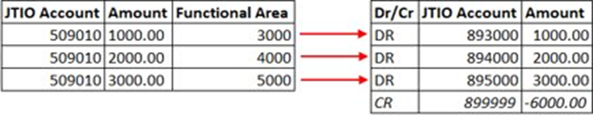
Functional Area Adjustment for P14 Posting (for Entities applicable)
CCODE | STAT | TAX | GBS
1171, 1172, 1197 | X | X | St Pete
1179, 1180 | X | X | St Pete
2154 | X |  | St Pete
1314 | X |  | Warsaw
1799 | X | X | Warsaw
1800 | X | X | Warsaw
2101 | X | X | Warsaw
Entities which make adjustments by Functional Area (FA) to comply with their STAT or STAT/TAX presentation requirements need to make corresponding FA adjustments for the P14 adjustments after those journals are posted.
Scope & Requirement
Entity sends email to GBS asking for completing FA Adj. after all P14 STAT/TAX Adj. posted in the respective ledger(s)
GBS takes the P&L movements for the range of relevant accounts in P14 and builds subtotal by Functional Area; using t-code FAGLL03H and layout "/INC3215289"
GBS prepares GL Journal Template by converting FAs to 89* GL accounts ₁₎
GBS adds 899999 GL as a balancing line
GBS Posts manual FA Adj journal in P14 in the required ledger(s) and request entity to validate the result following normal journal posting practice
P14 STAT/TAX FA ADJ Process
1)
For any further adjustments/corrections by FA beyond the standard FA adjustment program logics, the entity itself shall raise additional GL journal.
15

